Slide 1
Printed electronic functions on fabrics
K Yang, R Torah, J Tudor, Y Wei, Y Li, S Beeby
Dr Kai Yang Electronics and Computer Science University of Southampton Textile Thinking for Sustainable Materials Networking 2nd -3rd May, Loughborough University

Slide 2
Introduction
Smart Fabric Research Effort:
1 Professor
3 Senior Research Staff
8 PhD students
Developing printable functional materials on fabric
Research projects on smart fabrics:
Energy Harvesting Materials for Smart Fabrics and Interactive Textiles (EPSRC,£1.25M)
Microflex (EU Integrated Project, €8M)
Medifab (Wessex Medical Research, £20k)
Bravehealth (EU Integrated Project, €10M)
Intelligent prosthetics (UK MOD, £100k)

Slide 3
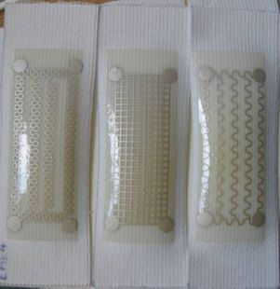
Why printed electronics and sensors?
Versatility of design
Flexible, conformable and comfortable
Short development time
Low cost
Suitability for small/medium series and mass production
Compatibility with a wide range of textiles

Slide 4
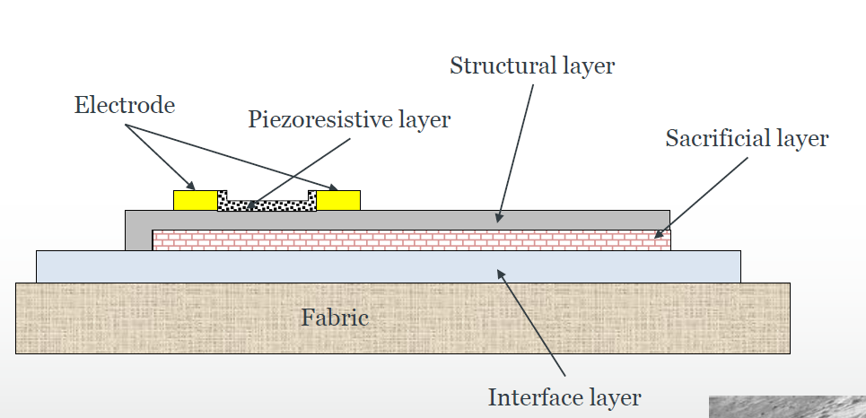
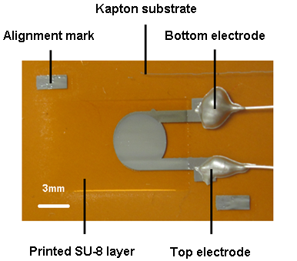
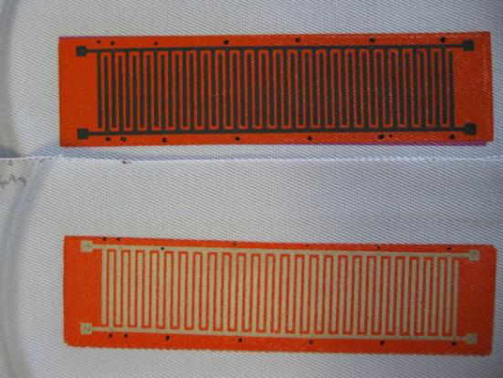
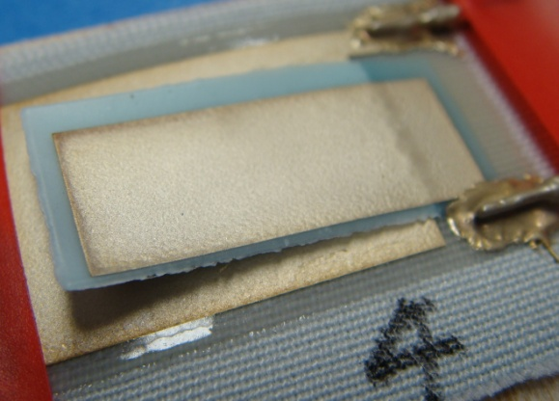
What do we print?
Wide range of materials:
Flexible interface
Dielectric, conductive, resistive
Piezoelectric & piezoresistive sensors
Sacrificial and structural films for mechanical structures
Figure 1: All ink jet printed capacitor
Figure 2: Screen printed heater on fabric
Figure 3: Screen printed cantilever on fabric

Slide 5
Further information
ECS www.ecs.soton.ac.uk
Microflex www.microflex.ecs.soton.ac.uk
Smart Fabric Inks Ltd www.fabinks.com
Printed smart fabrics LinkedIn group
http://www.linkedin.com/groups?gid=4295957&trk=hb_side_g
FLEX
µ

